Slide 1
SR UNIVERSITY
STU6422f769acb711680013161
R. POOJA REDDY
Week-02: Data Visualizations
Production Analysis of Indian States

Slide 2
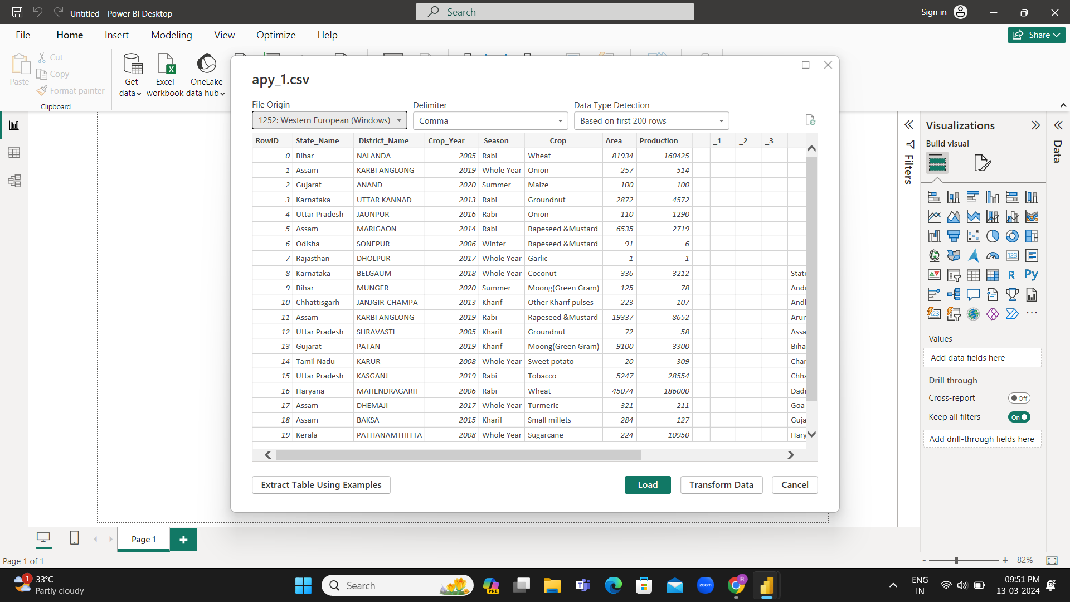

Slide 3
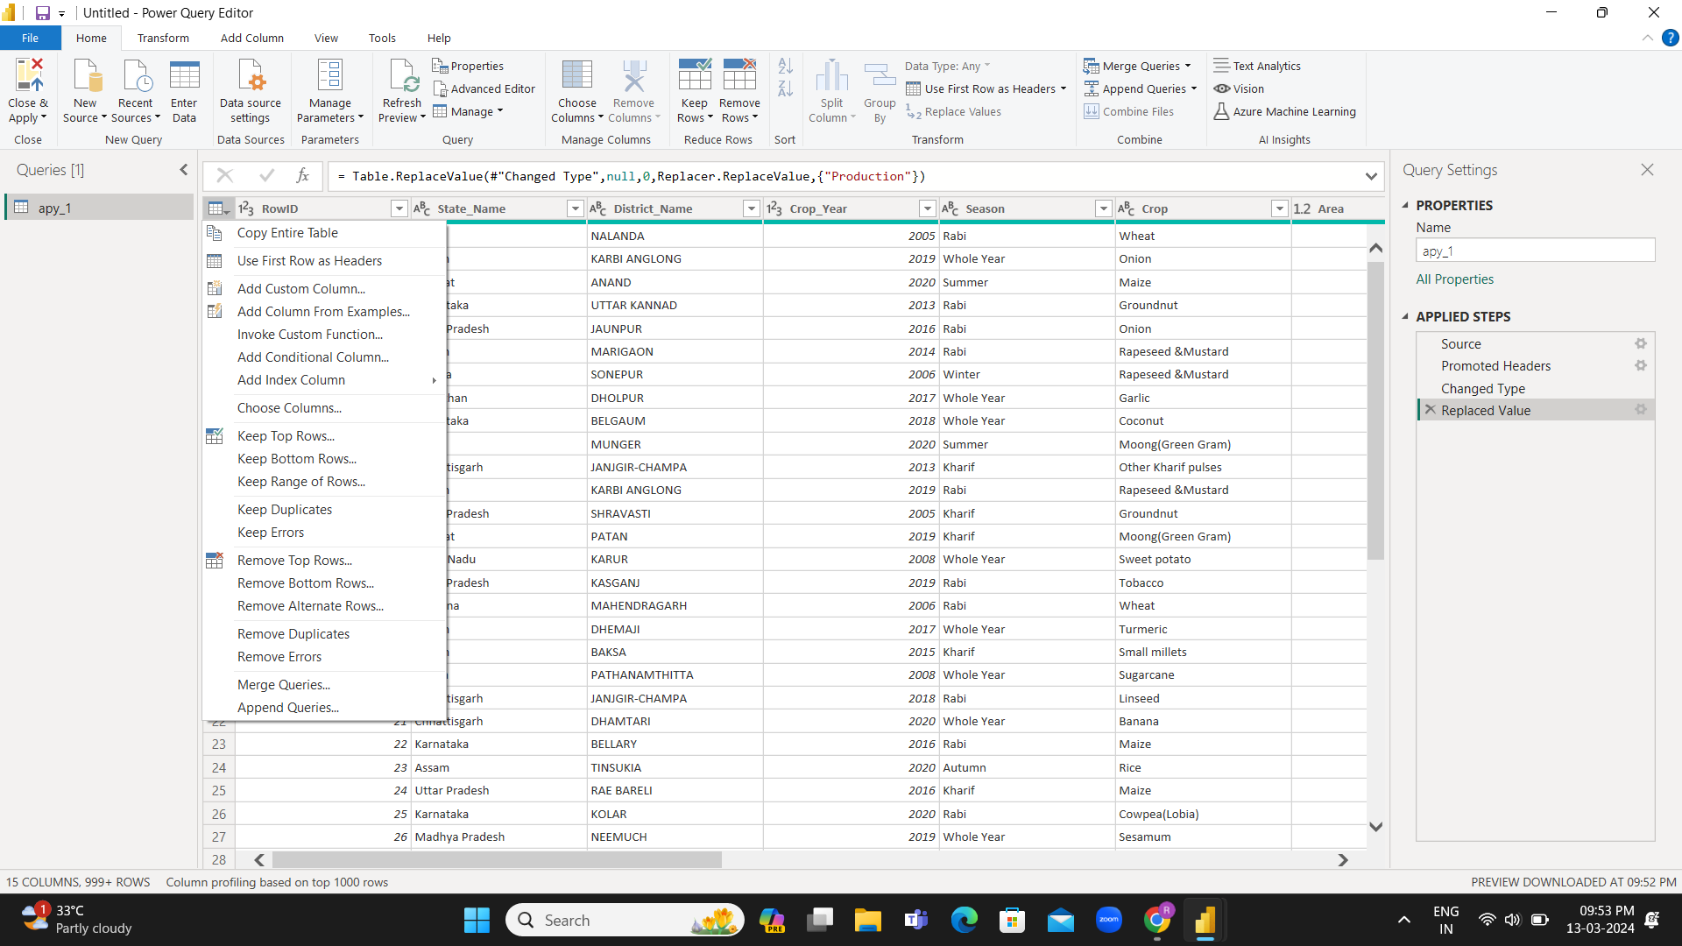

Slide 4
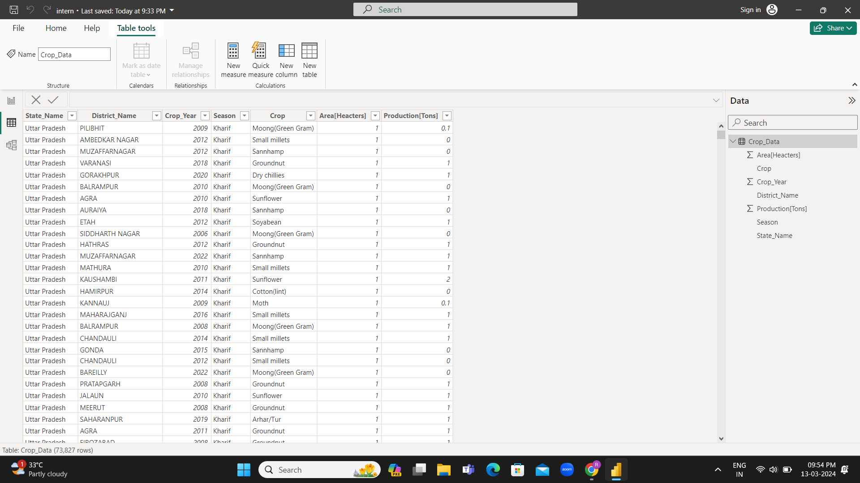

Slide 5
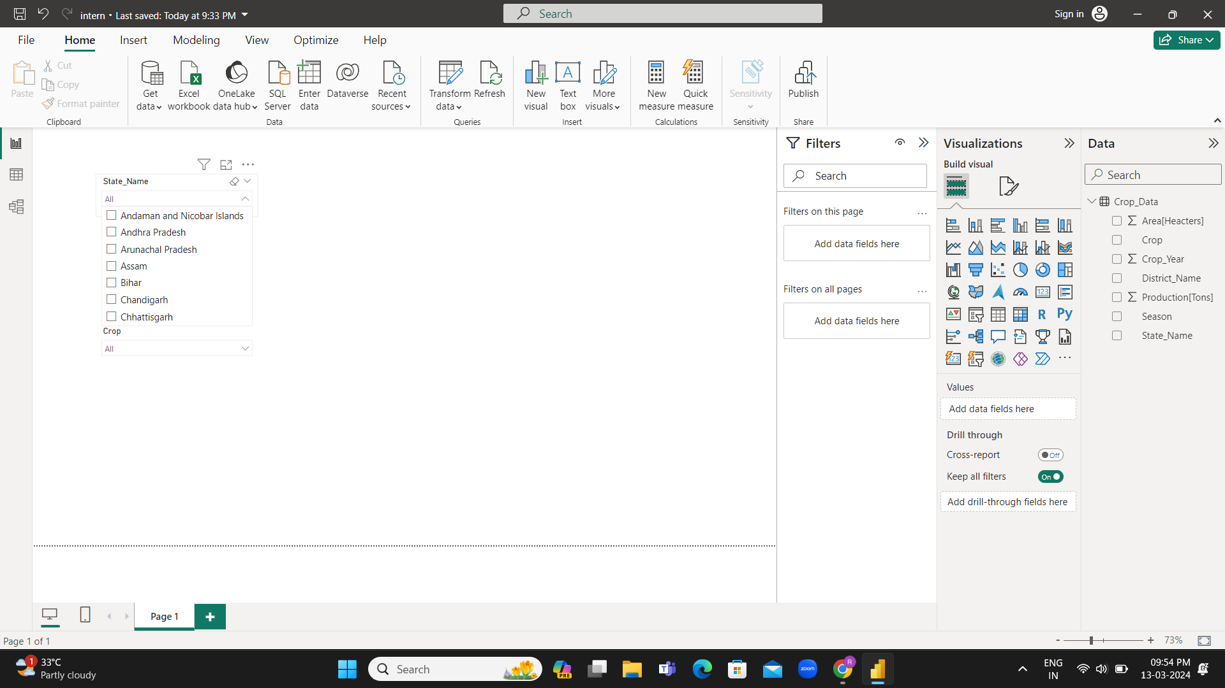

Slide 6
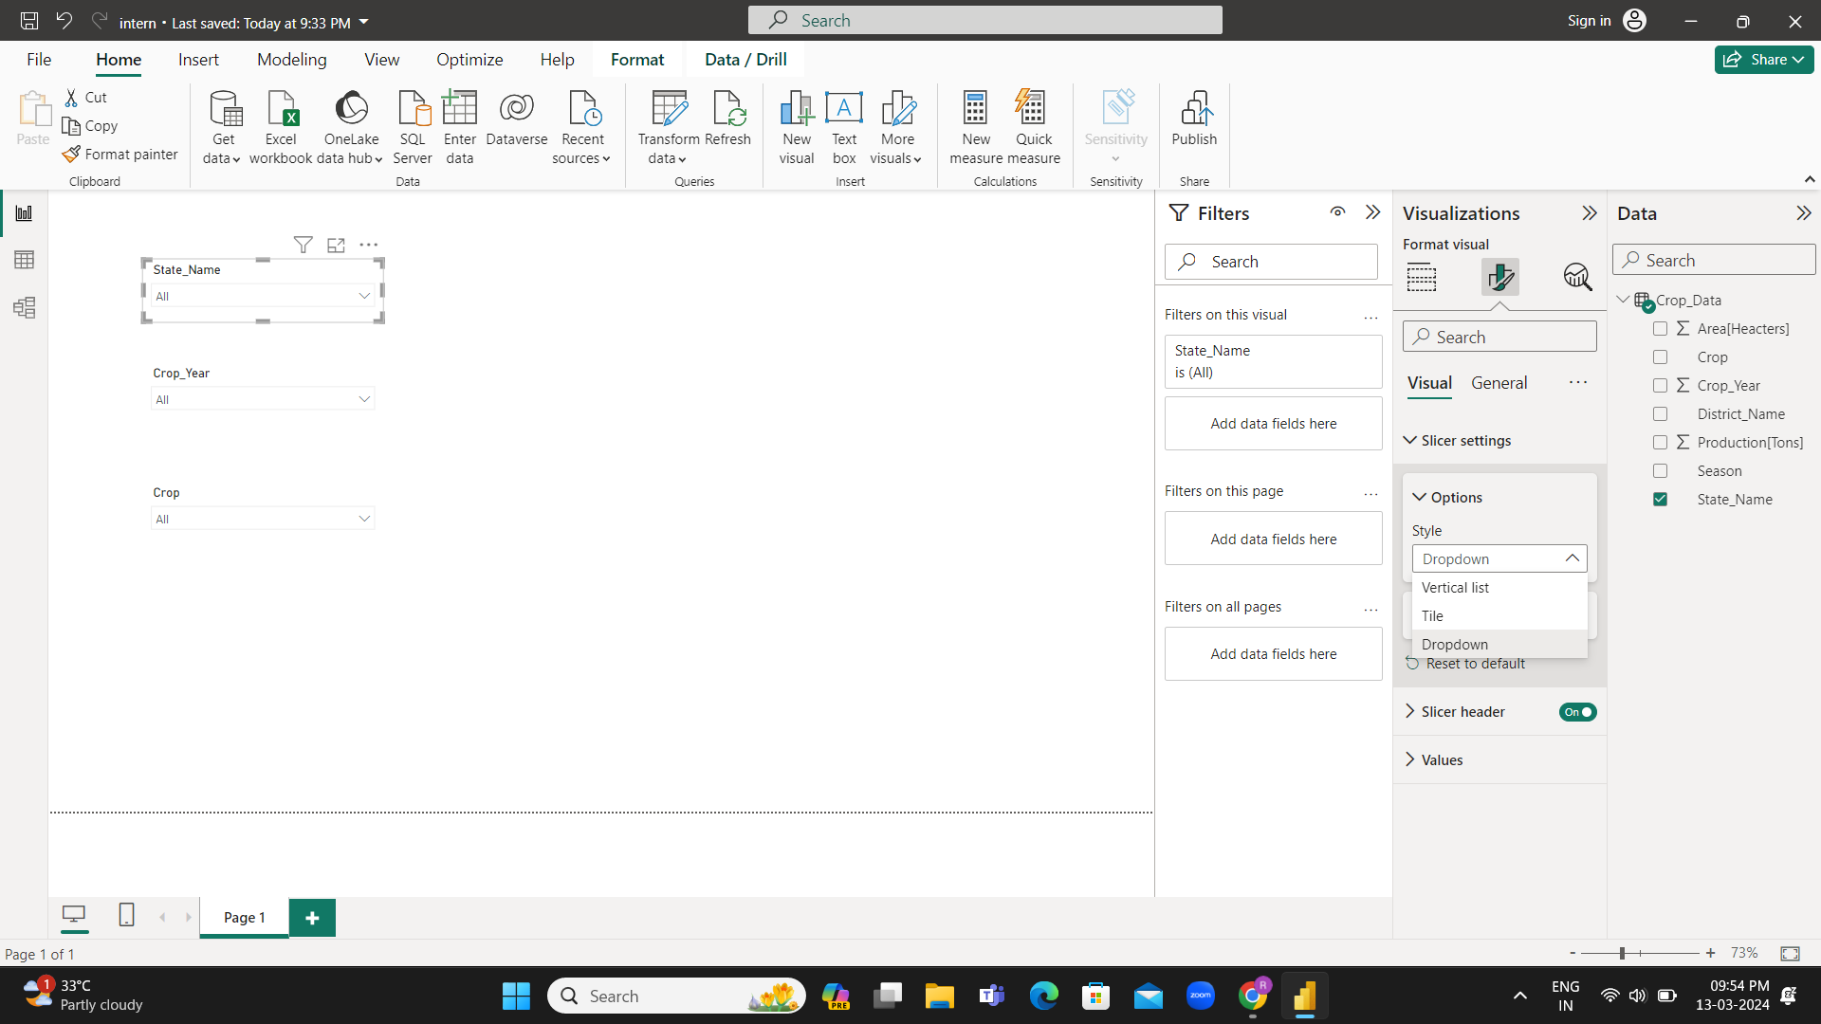

Slide 7
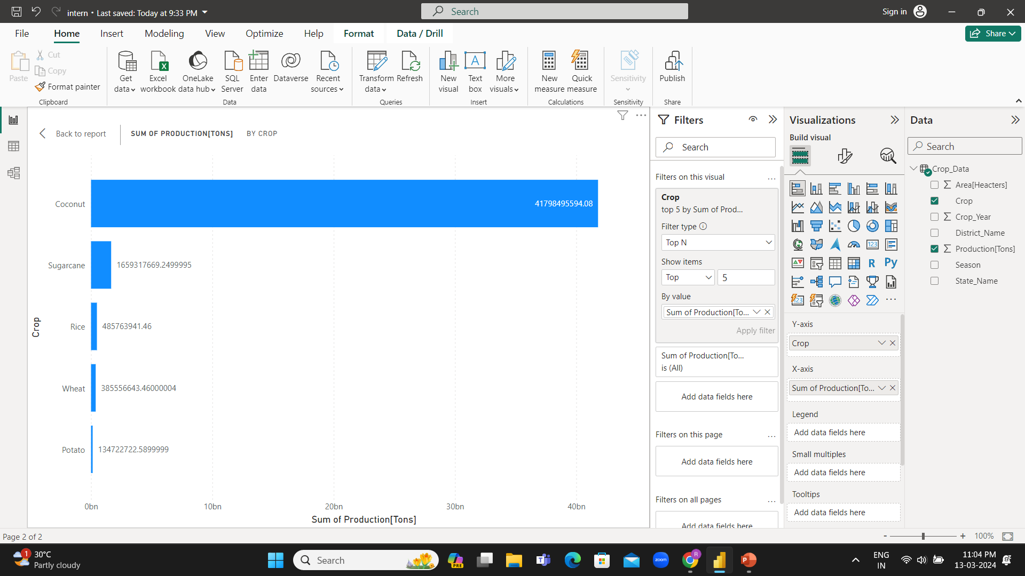
Top 5 Crops by Production ➔Stacked Bar Chart

Slide 8
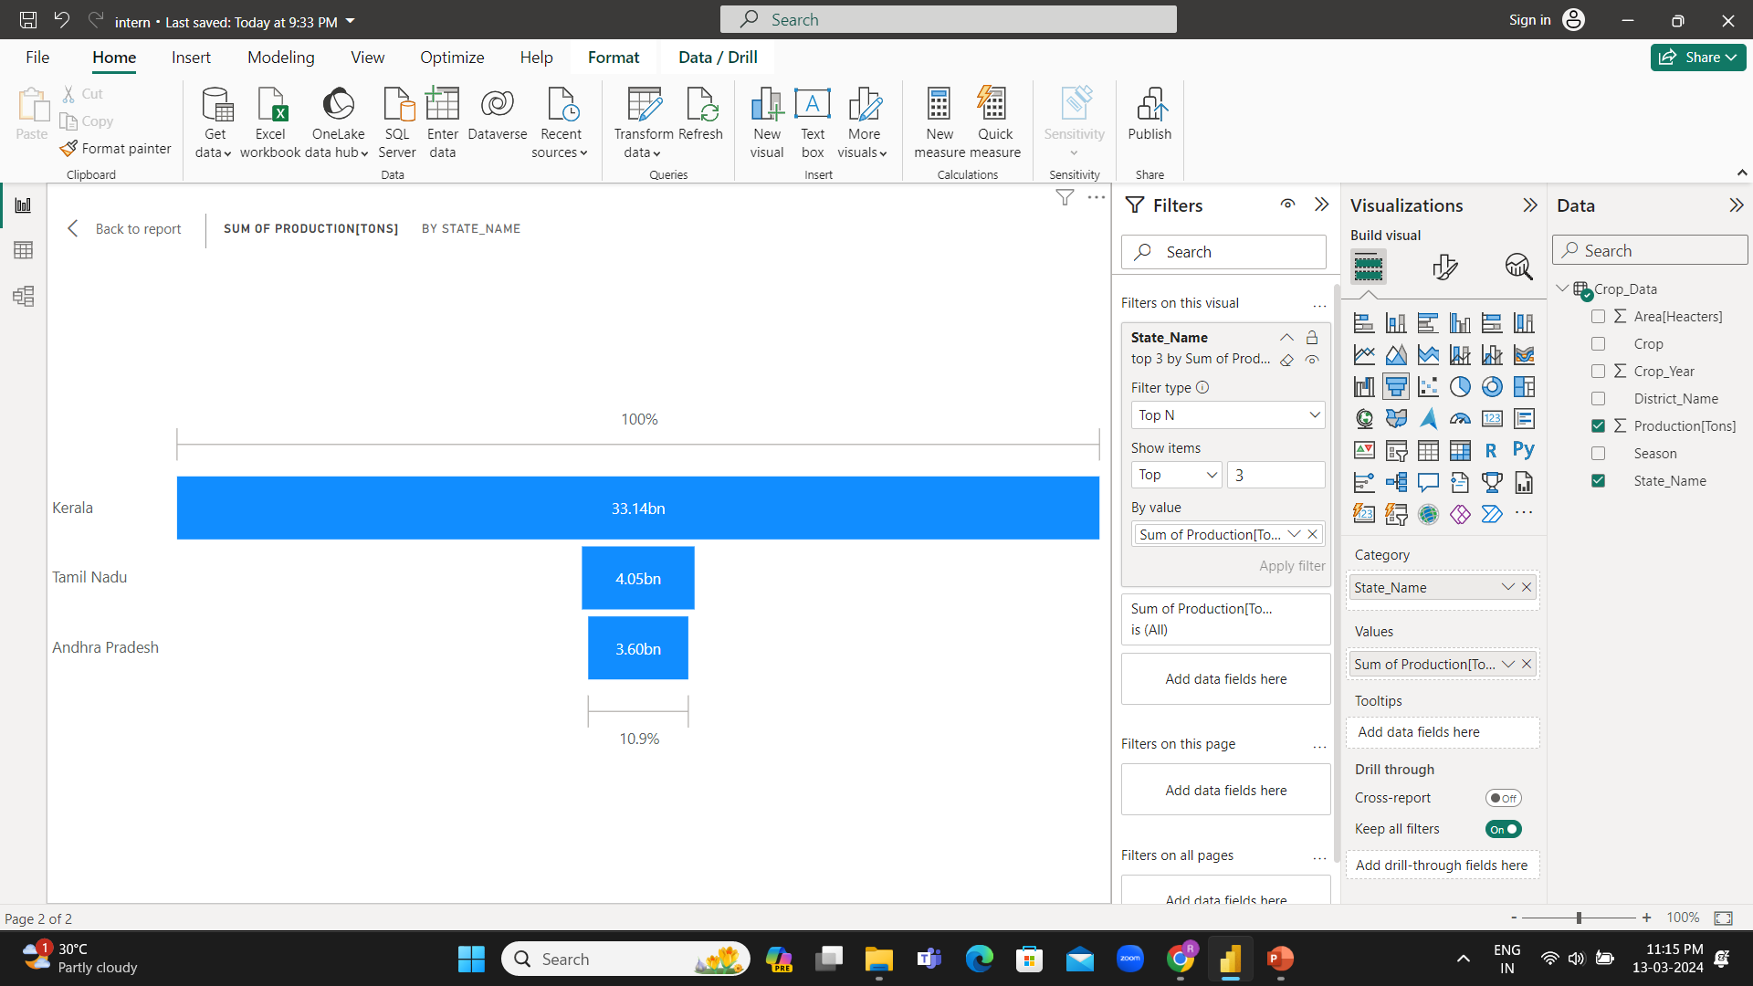
Top 3 States by Production ➔Funnel Chart

Slide 9
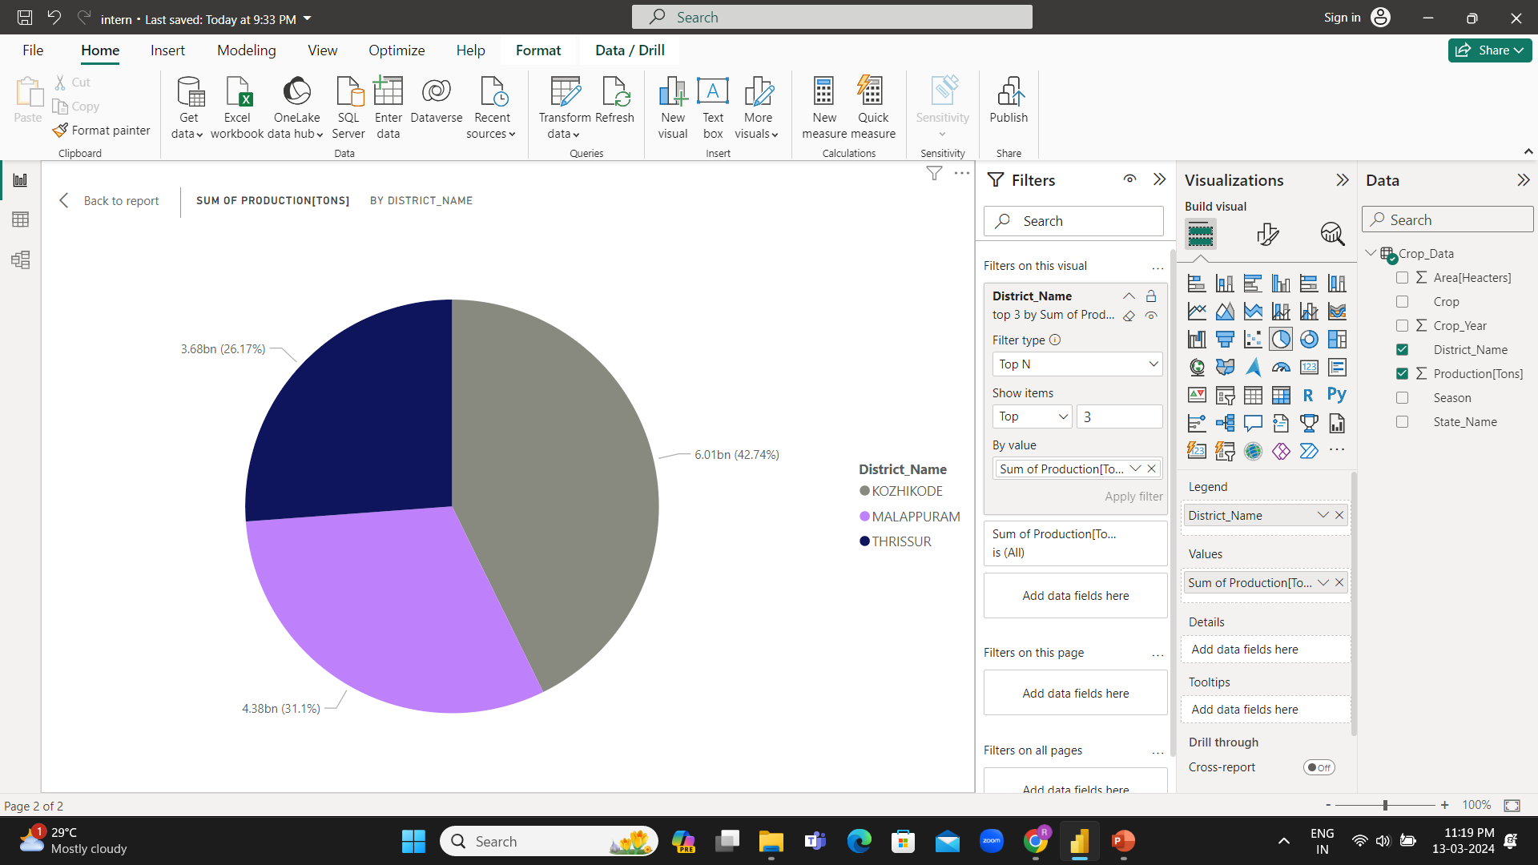
Top 3 Districts by Production ➔Pie Chart

Slide 10
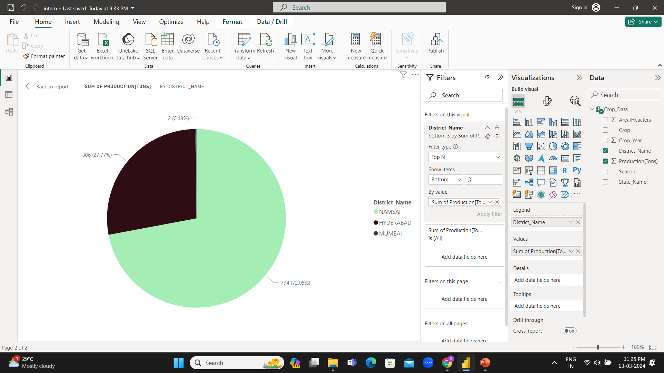
Bottom 3 Districts by Production ➔Pie Chart

Slide 11
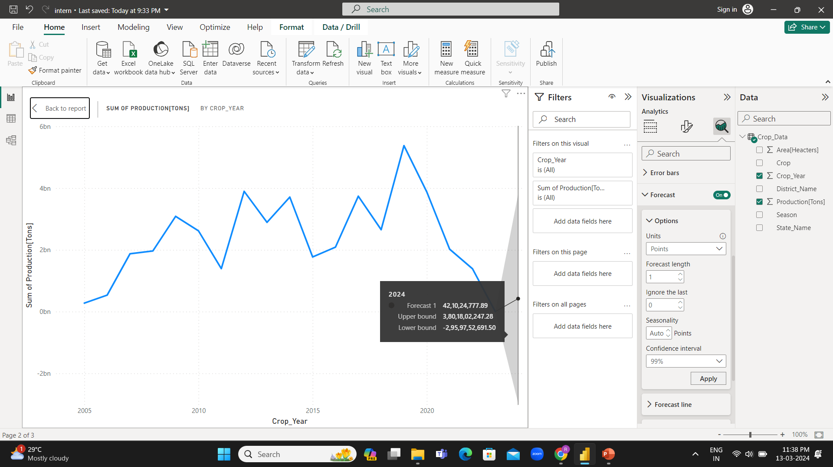
Prediction of Production by 1 Year ➔ Line Chart

Slide 12
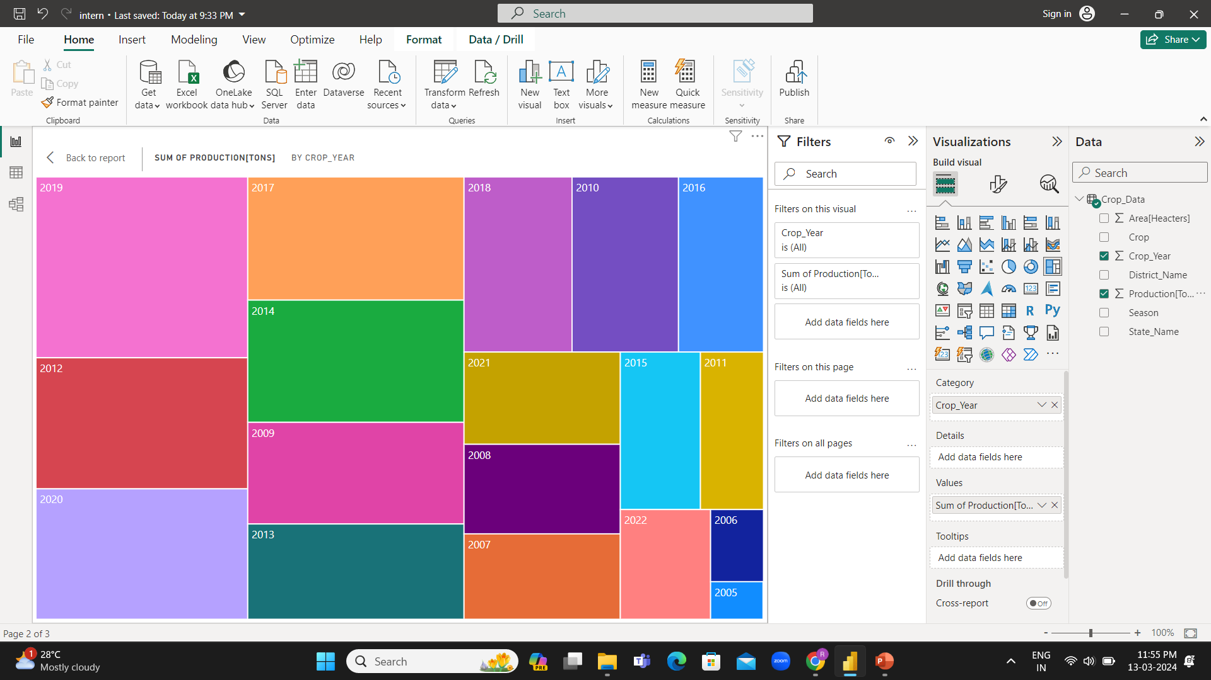
Production by Each Year ➔ Treemap

Slide 13
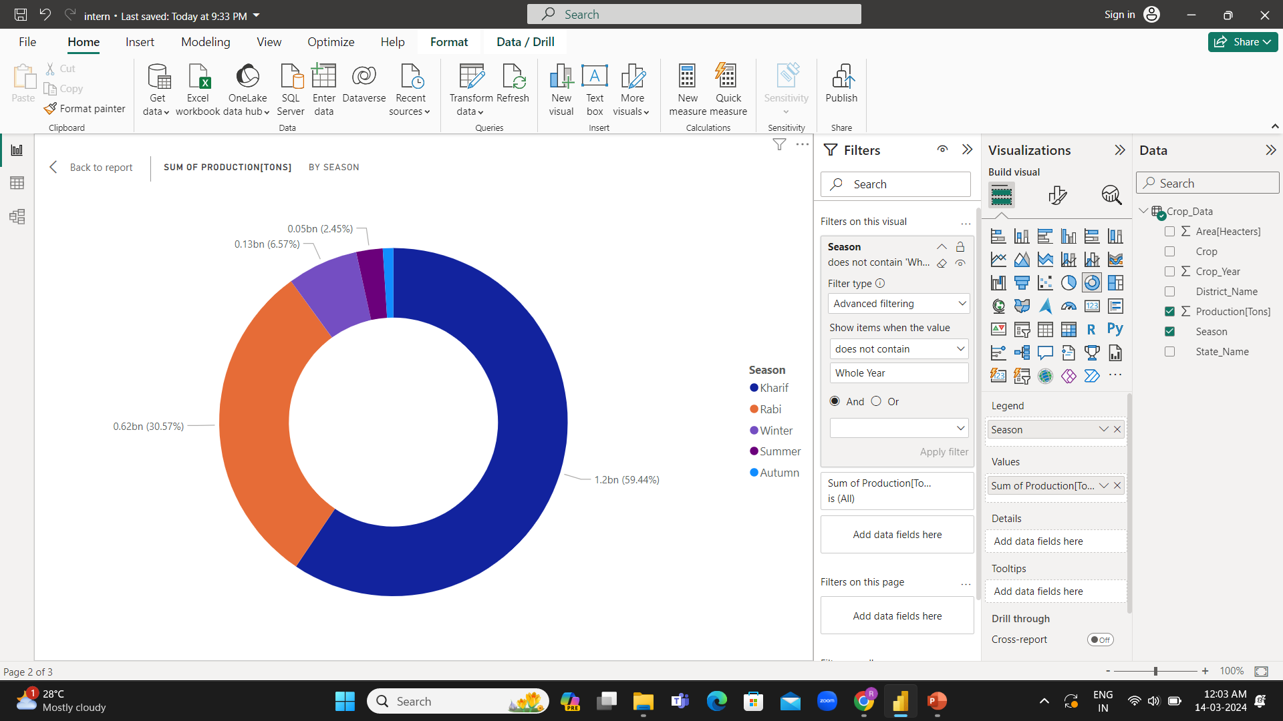
Production by Each Season ➔ Donut Chart

Slide 14
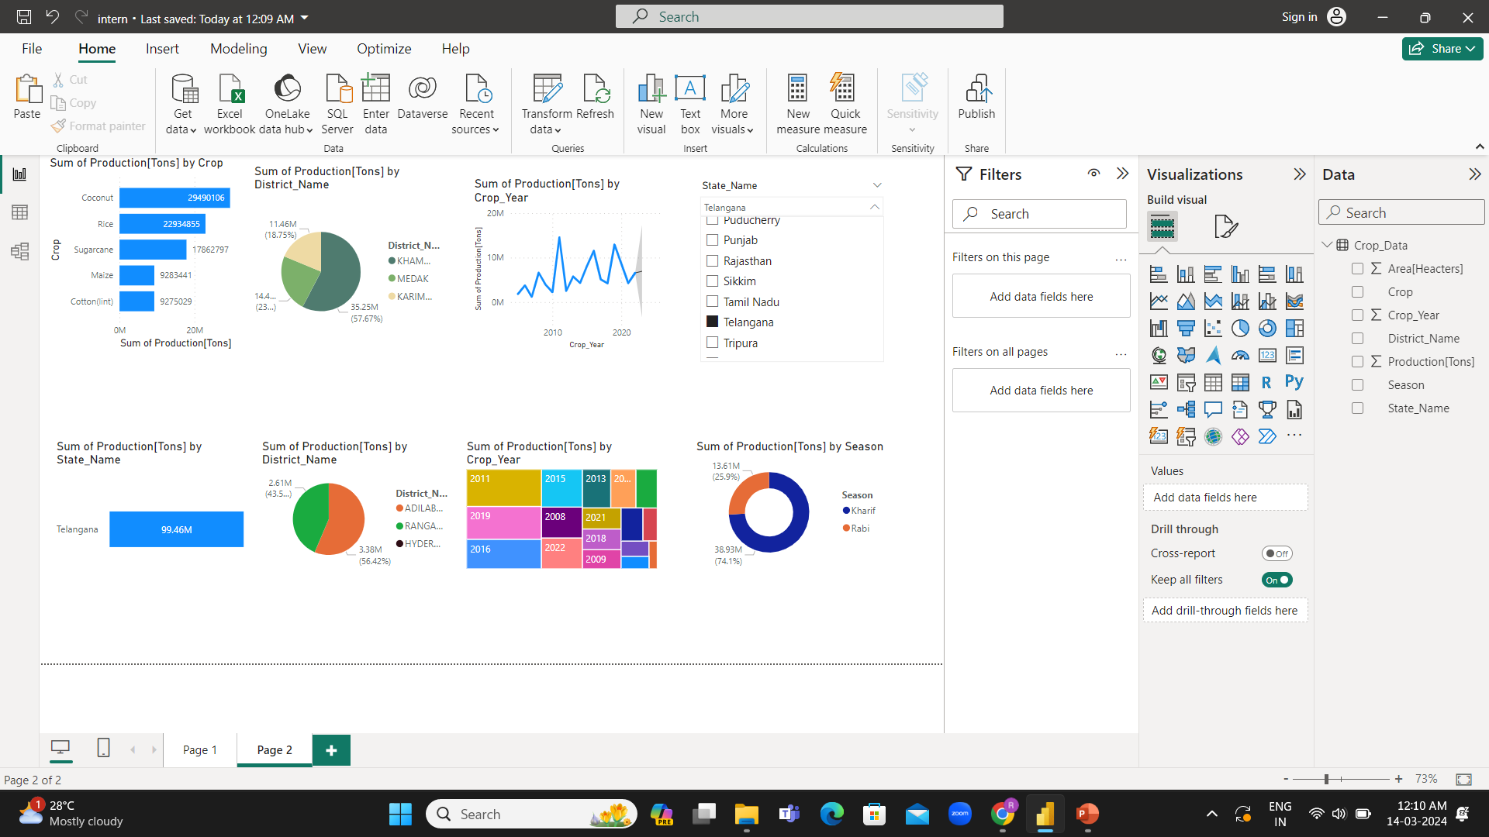
Summary:

Slide 15
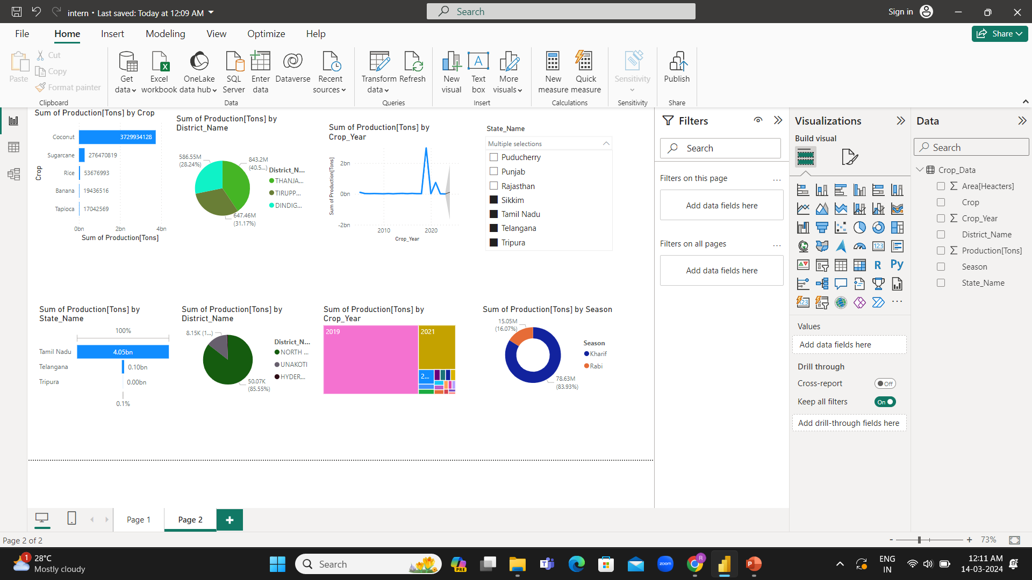

Slide 16
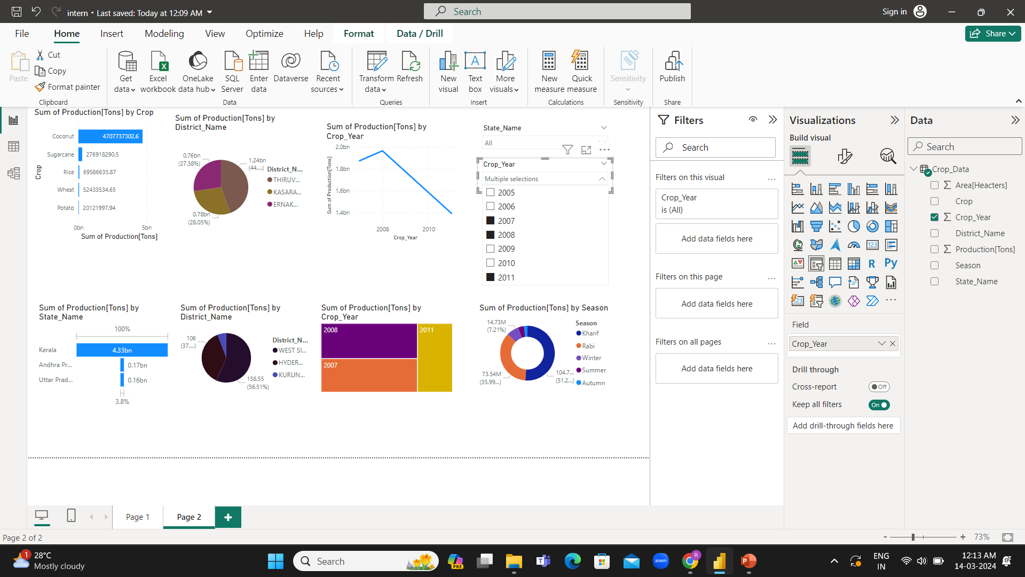

Slide 17
